Slide 1
Evaluation boards for SLB
2025/4

Slide 2
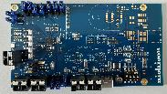
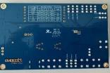
SLBEVAPAS01
SLB Series Energy Harvesting Evaluation Board with 20C USB type-C charging
Nichicon “SLB” series are “Small Lithium Titanate Rechargeable Batteries” ideal for powering IoT systems. The SLBEVAPAS01 is an evaluation board that allows users to test the SLB series with combining various types of energy harvesting devices. With a built-in power management IC from E-Peas, the harvesting can be optimized via jumper configurations. The board is equipped with a rectifier for AC harvesting source. To enable fast evaluation, the board features an USB-C input for quick SLB charging with up to 400mA.
Built-in rectifier for solar (DC) and vibration power generation (AC)
Supports power collection optimization via jumper settings
USB -C charging with up to 20C (400mA) charge current via dip switches
Supports various outputs (1.14V-3.34V)
High customizability
11 measure and test points for evaluation purposes
PMIC E-Peas AEM30330 with configuration jumpers (i.e. MPPT, load configuration etc.)
PCBA size: 110 x 60mm

Slide 3
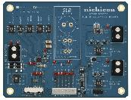
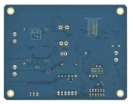
EVSLB-EHEP02A
SLB Series Energy Harvesting Evaluation Board
Nichicon “SLB” series are “Small Lithium Titanate Rechargeable Batteries” ideal for powering IoT systems. The EVSLB-EHEP02A is an evaluation board that allows users to test the SLB series with combining various types of energy harvesting devices. With a built-in power management IC, the power collection efficiency can be optimized according to the energy harvesting element used. It is also equipped with 2 types of power output, it can be used properly according to the application. The EVSLB-EHEP02A provides an easy way to configure the energy harvesting powered source.
Solar (DC), vibration power generation (AC), etc. Input from various harvesters are possible
Supports power collection settings optimized for harvester characteristics
Compatible with all 5 types of SLB series
Supports 2 outputs (SLB direct / 3-5V)
High customizability
PCBA size: 90 x 70mm

Slide 4
EVSLB-AAA
SLB Series Energy Harvesting Evaluation Board for replacing AA/AAA disposal battery
Nichicon “SLB” series are “Small Lithium Titanate Rechargeable Batteries” ideal for powering IoT systems. The EVSLB-AAA is an evaluation board for evaluating the SLB series in combination with PV (solar cells). It is very easy to replace existing devices powered by AA or AAA dry cell batteries in series. It has a built-in power management IC, and you can optimize the power collection efficiency according to the environment power generation element you are using. It is also possible to charge it quickly from USB-C. EVSLB-EVSLB-AAAprovides a simple way to configure a power supply using environment power generation.
Compatibly of AA/AAA battery from factor
Energy harvesting connection
MPPT (maximum power point tracking) control
USB-C charging port
Various battery mounting
PCBA size: 44.5 x 10.5 mm

Slide 5
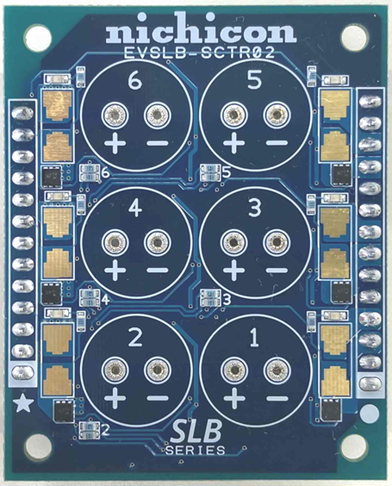
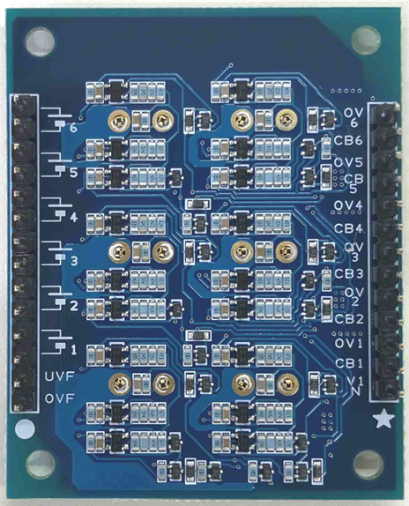
EVSLB-SCTR02
SLB Series Multi-cell Evaluation Board
Nichicon “SLB” series are “Small Lithium Titanate Rechargeable Batteries” ideal for powering IoT systems and power supply backup. The EVSLB-SCAB01 is an evaluation board for the SLB series. Up to six SLB series batteries can be connected in series or parallel to provide the voltage and capacity required to drive the circuit. Furthermore, it is also possible to achieve even higher voltages and capacities by connecting the evaluation board itself. The output is able to use as the power source for the 12V or 5V, and it is equipped with cell balance adjustment, overcharge, and over discharge sensing functions. Simply insert the SLB battery to start evaluation. Furthermore, it is possible to easily configure a backup circuit by connecting a backup daughter board.
Up to 6 SLBs connection series or parallel
Available for the 5V/12V backup power supply
Multiple boards connection
Cell balancing circuit
Push in socket without soldering
Over charge and over discharge sensing Daughter connection for constructing backup power supply circuit
Customizable function threshold
PCBA size: 45 x 56mm

Slide 6
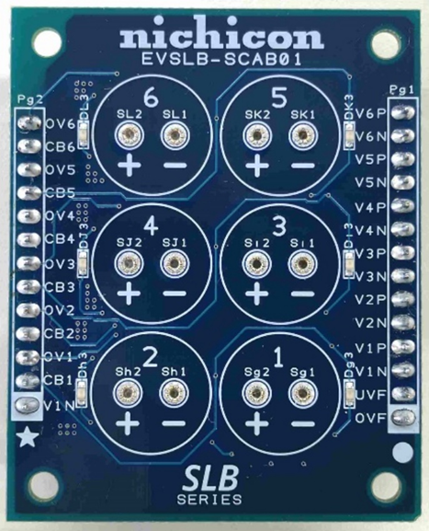
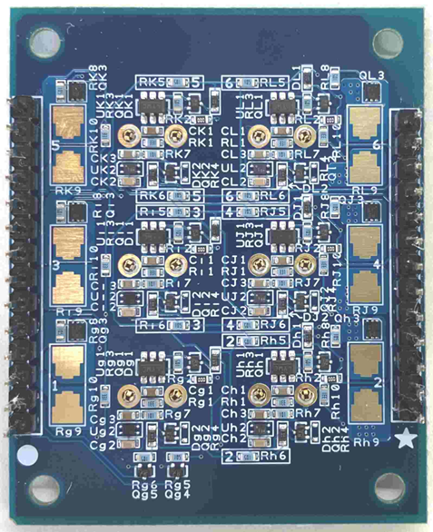
EVSLB-SCAB01
SLB Series Multi-cell Evaluation Board
Nichicon “SLB” series are “Small Lithium Titanate Rechargeable Batteries” ideal for powering IoT systems and power supply backup. The EVSLB-SCAB01 is an evaluation board for the SLB series. Up to six SLB series batteries can be connected in series or parallel to provide the voltage and capacity required to drive the circuit. Furthermore, it is also possible to achieve even higher voltages and capacities by connecting the evaluation board itself. The output is able to use as the power source for the 12V or 5V rails, and it is equipped with cell balance adjustment, overcharge, and over discharge sensing functions. Simply insert the SLB battery to start evaluation. Furthermore, it is possible to easily configure a backup circuit by connecting a backup daughter board.
Up to 6 SLBs connection series or parallel
Available for the 5V/12V backup power supply
Multiple boards connection
Cell balancing circuit
Push in socket without soldering
Over charge and over discharge sensing Daughter connection for constructing backup power supply circuit
Low power consumption
PCBA size: 45 x 56mm

